Slide 1

Speed Typing Game
By-
Rishith Singh Rawat 088
Samarth Patel 098
Sameer Khatwani 099

Slide 2

Introduction
The speed typing game in Java is a game as well as a mock test for programmers and gamers alike to practice their typing skills to avoid typos and or small errors that could affect the code or gameplay of computer users

Slide 3

Motivation
In a bustling world where time is often our most precious commodity, mastering the art of typing swiftly is like wielding a superpower.
The motivation behind engaging in speed typing tests lies in the pursuit of refining one's proficiency in information processing and communication. Through disciplined practice and the meticulous honing of motor skills, individuals endeavor to enhance their typing speed, thereby streamlining workflow processes and bolstering overall productivity

Slide 4
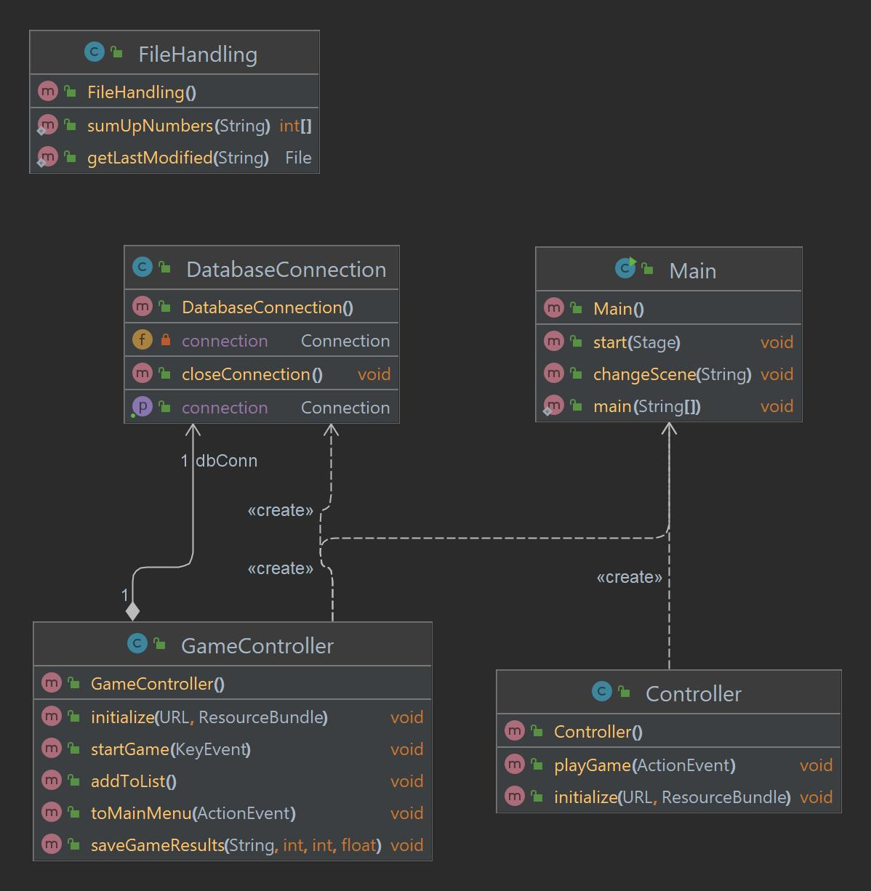
Class Diagram

Slide 5


Java Concepts Used
Exception handling
Abstraction
Encapsulation
Inheritance
Association
Polymorphism

Slide 6
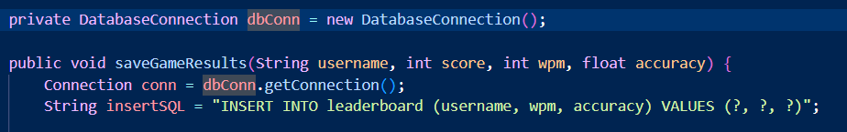
Association
Association is a relationship between two or more classes that describes how objects of those classes are related to each other. In association, objects of one class are connected to objects of another class through their instance variables or methods. There are 3 types of association:
One-to-One
One-to-Many
Many-to-Many

Slide 7
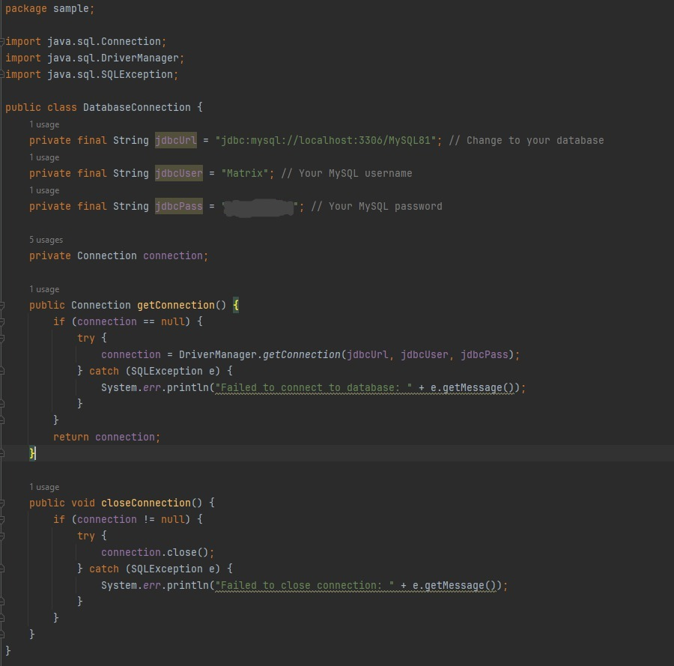
Java Database Connectivity
The provided Java class, located in the "sample" package, establishes a connection to a MySQL database. It imports essential classes from the "java.sql" package for database connectivity and management. Within the class, private final String variables hold the JDBC URL, username, and password for the MySQL database. The class includes a private Connection variable to store the established database connection. The getConnection() method fetches a connection to the database using DriverManager.getConnection(), while the closeConnection() method closes the connection. These methods handle SQLExceptions gracefully, printing error messages if necessary. Overall, the class encapsulates database connectivity logic, offering methods to retrieve and close connections, and providing a streamlined approach to interact with the MySQL database.

Slide 8
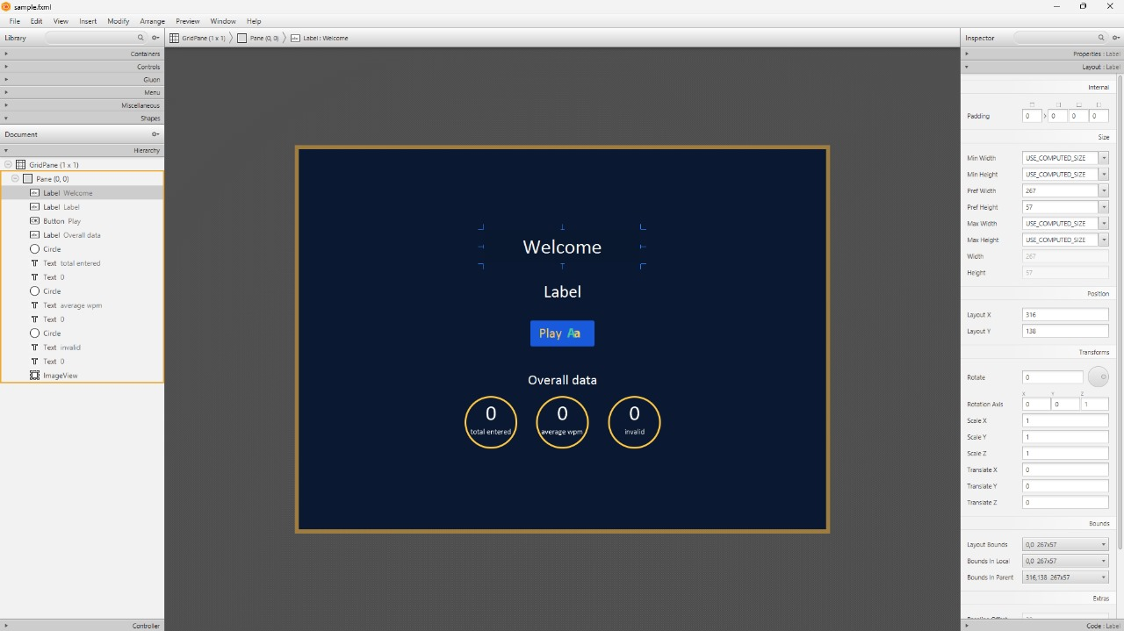
Front End (Output of our Project)

Slide 9
Inferences
As we worked on this project, we understood the basics of Java and database connection using Java. The project had some challenges regarding the use of JavaFX or Springboot since the projects were not very good.

Slide 10
Thanks!

